Slide 2
Modern Data Warehouse Patterns and Practices
Jan Remko Yntema
Data Architect
ilionx
jryntema@ilionx.com

Slide 3
Architectures

Slide 4
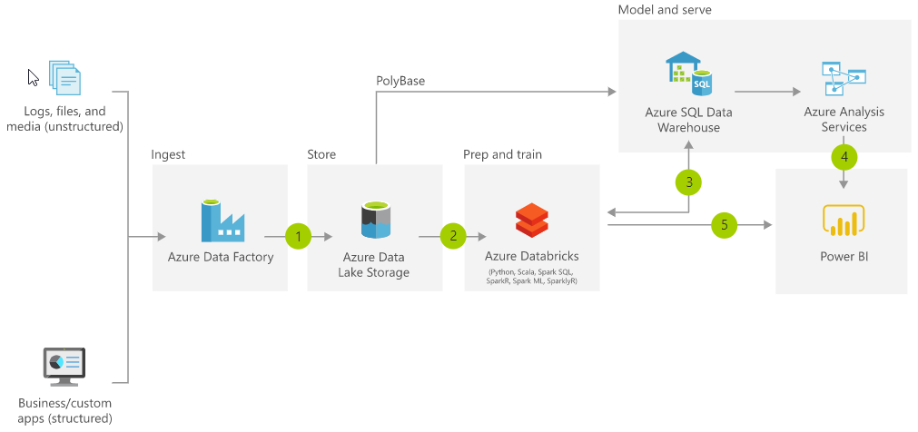
Modern Data Warehouse

Slide 5
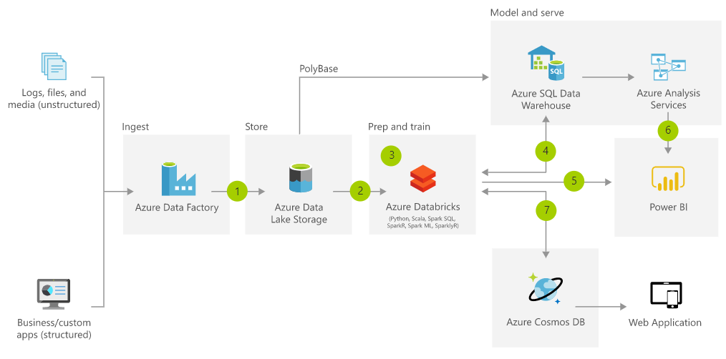
Advanced analytics on big data

Slide 6
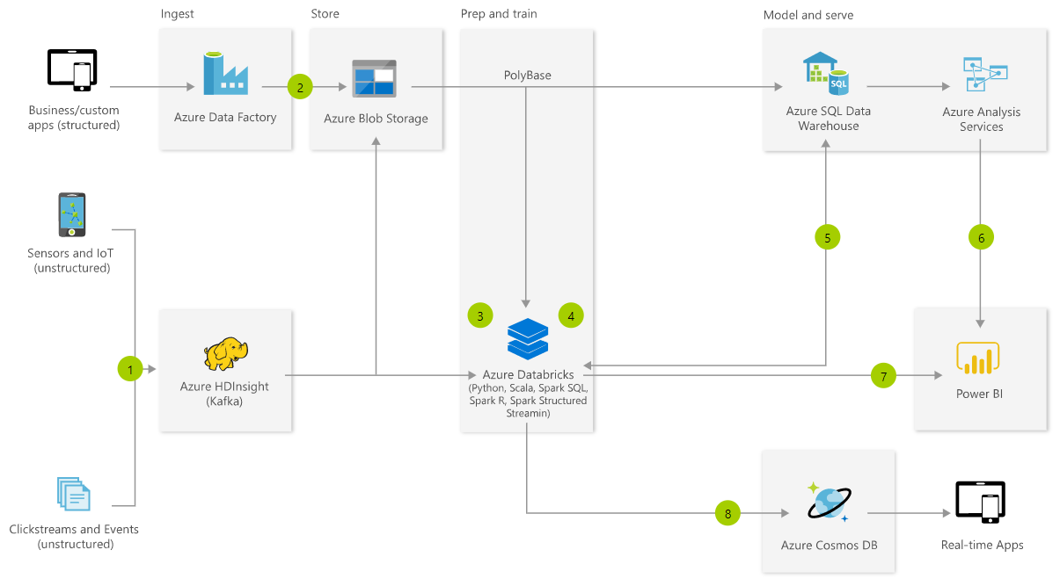
Real-time analytics

